Slide 1
Commonwealth Government Rorts 2013-2021 ?
An Analysis of some Coalition grant programs. And a discussion about the findings of the analysis. One man’s view.

Slide 2
Overview 1
2018 Government creates GrantConnect portal
Before that, grant Schemes were reported on individual Departmental web sites.

Slide 3
Overview 2
GrantConnect data to date. (in $ Billions)
2018 24,446 Grants = $20,404,436,019.77
2019 23,973 Grants = $16,606,715,606.13
2020 44,073 Grants = $15,719,459,198.66
Total 92492 Grants = $52,730,610,824.56

Slide 4
Overview 3.
Sports Australia was formed under the Australian Sports commission Act of 1989 and is a wholly owned yet independent government entity.
The Lead Department responsible for Sport Australia is the Department of Health. (Important).

Slide 5
Overview 4
Sport Australia is authorised under it’s Act to approve grants with money appropriated by the Australian Parliament for that purpose.
The Board is the Authorising Authority. (Important).
Sport Australia can have their own guidelines for grants.

Slide 6
Overview 5.
All other Commonwealth Grants are covered by the Commonwealth Grants rules and guidelines issued under regulation by the Department of Finance.
These rules were instigated in 2008 by the Rudd Labor government when Lindsey Tanner was Finance Minister.

Slide 7
Grants Analysed by Vince O’Grady 2013 – 2019
1/ Sports Administration Infrastructure (Sports Rorts) Value $100 Million

Slide 8
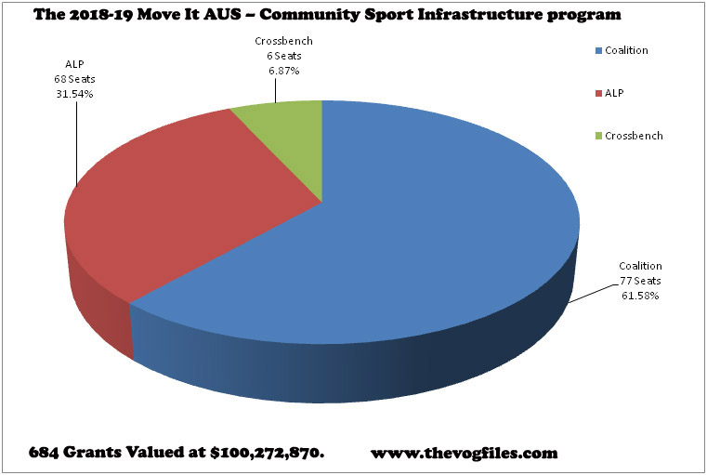
Sports rorts.

Slide 9
Community Development Grants 2013-2019
Community Development Grants (CDG)
Value $1.1 Billion

Slide 10
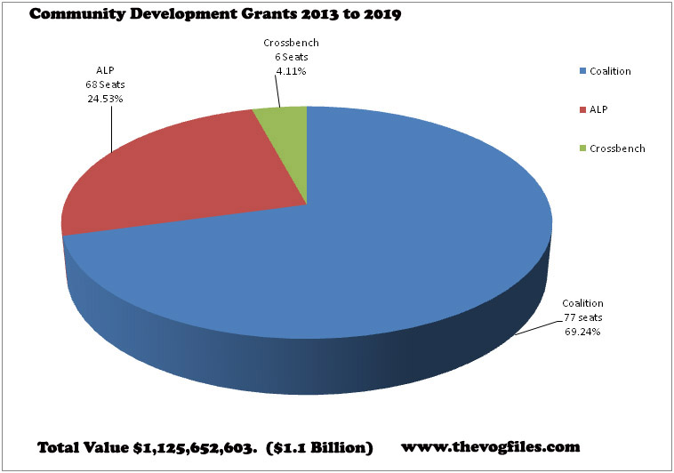
Community Development Grants

Slide 11
Regional Grants Programs 2013-2019
Regional Grants Programs
Value $714 million.

Slide 12
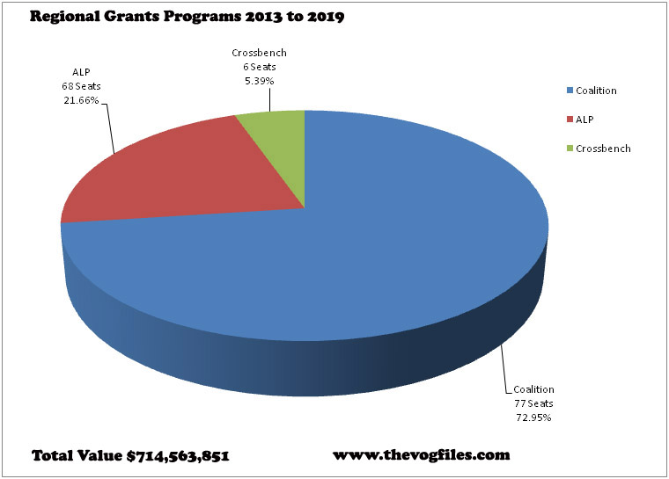
Regional Grants Programs

Slide 13
Further Grants Programs analysed for 2020.
Community Development Grants $392M
Building the Better Regions Fund (BBRF) $158M
Drought Communities Fund $188 M
Local Roads and Community Infrastructure
$499 M.

Slide 14
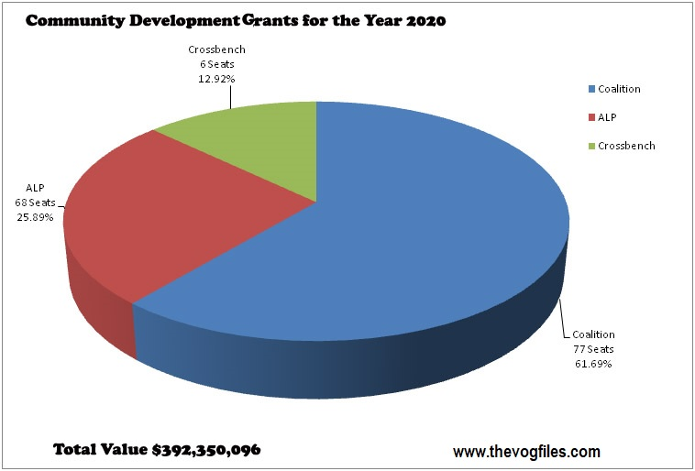
Community Development Grants 2020

Slide 15
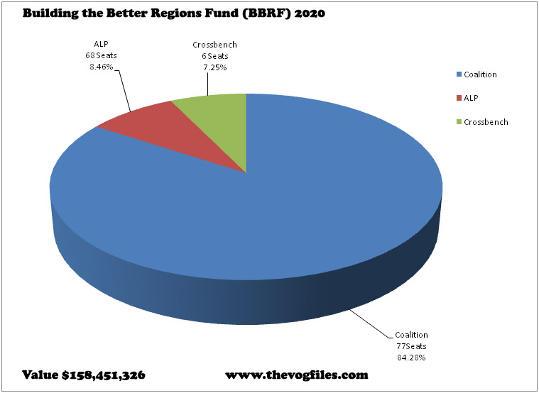
Building Better Regions Fund (BBRF) 2020

Slide 16
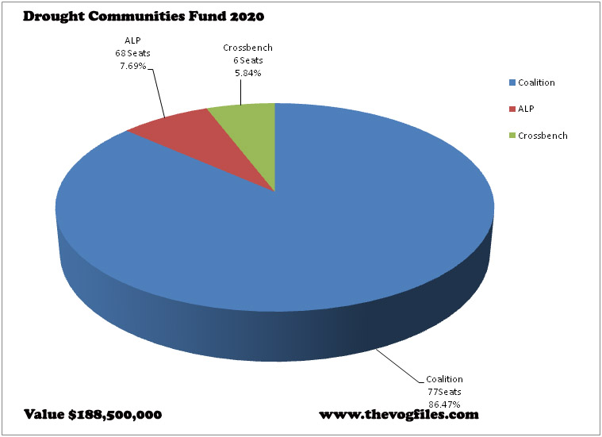
Drought Communities Fund 2020

Slide 17
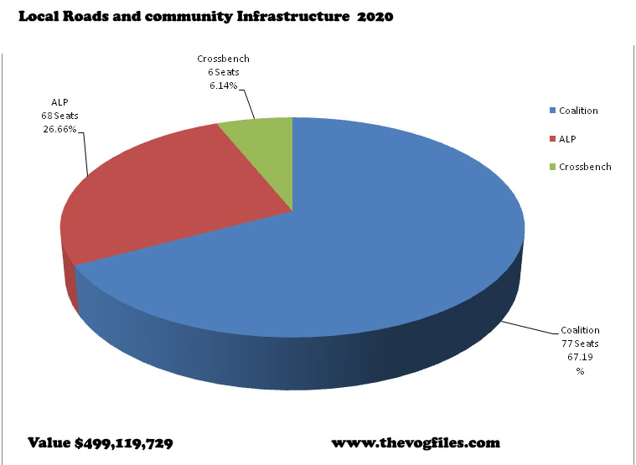
Local Roads and Community Infrastructure 2020

Slide 18
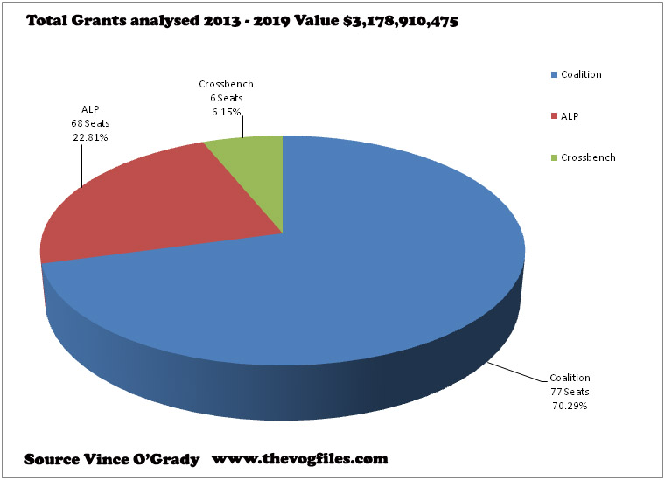
Summary all Analyses.

Slide 19
Back to Sports Grants (more detail)
2056 applications value $396.6 M
Became 1941 applications $384.6 M
684 were successful $100.2 M
So 1257 were unsuccessful.
80 out of those 1257 unsuccessful applications ended up being funded by CDG grants and are under further investigation and analysis.

Slide 20
Why?
Why is this remarkable?
The Ministers for Sport’s office asked Sport Australia for details of all applications. They refused. But got copies anyway (somehow).
The evaluation had been done under a strict set of guidelines. Sport Australia recommended grants to The Minister and she could alter them but had to give reasons. (Which she didn’t)

Slide 21
Why 2
The CDG scheme was also covered by a set of guidelines BUT it was a closed scheme and only those identified and invited were allowed to apply.

Slide 22
Legalities.
Legal Concepts. Was this Sports Grants scheme:-
Legal under the constitution?
Did Minister MacKenzie have the power under the Australian Sports commission Act 1989 to approve Grants? (Statute Law)
Were the Commonwealth Grants rules and guidelines applicable? (Regulations under Statute law)

Slide 23
Legalities 2
Were there any other breaches of Criminal law relating to the administration of the Sports grants? (Criminal law covered under Statute).

Slide 24
Answer to legalities 1
A submission (#14) to the Senate Select Committee inquiring into the Sports Infrastructure Grants covers the
Constitutional
Possible Statute law breaches
Possible breaches against Regulations made under Statute Law
The Author of this submission was Professor Anne Twomey Law dept Sydney University.

Slide 25
Answer to Legalities 2
Synopsis of Evidence. (Criminal offences?)
On 4th April 2019, the Minister says she signed the brief for the final round 4 approvals.
Yet in the interim between 4th April and 11th April, when the 2019 election was called 9 New and amended applications were added to the list under the 4th April approval and the Minister (in evidence) claims no knowledge.

Slide 26
Answer to Legalities 2
There was correspondence between the Prime Minister’s Office and the Minister’s Office during this time asking for Grants to be removed and added back in.
The Minister has given evidence to the Senate Select committee that she did not know about the changes or who did them.

Slide 27
Answer to Legalities 2.
Therefore it appears that there is a Prima Facie case of a Forgery of a Commonwealth document under The Criminal Code of the Commonwealth of Australia.
Specifically Division 144 – Forgery.
Forgery 144.1(5) (a) (i) and (ii)
Using a forged document 145.1 (1) (a) (i) and (ii)

Slide 28
Answer to Legalities 2
Possession of a forged document 145.2 (1) (a) (i) and (ii)
Complicity and common purpose Section 11.2.
(1) Aids, abets counsels or procures the commission of an offence by another person is taken to have committed that offence and is punishable accordingly.

Slide 29
Conclusion
It appears that the Sports grants scheme was Illegal in several ways as it may have breached
The Constitution
Statute Law (Sports Administration Act)
Regulations under Statute law (Grants rules and guidelines) and
Criminal law the changing of the final approved document after it had been signed.

Slide 30
Conclusion cont’d
It appears that this Government has no checks and balances in their dealing with finances and seem to make it up as they go along.
There is a definite need for an Integrity Commission with wide powers to stop these abuses.

Slide 31
What Abuses?
From my analyses it appears that the Government is using public money to buy votes.
The makeup of the parliament in 2019 is as follows. (151)
44 Liberals 23 LNP and 10 Nationals seats
68 Labor seats
6 Crossbench seats

Slide 32
What Abuses? 2
If you look at the allocation of 3 Billion it went as follows (Average per seat)
Over 151 seats $21 M per seat
Liberal 44 seats actual $25.3 M per seat
LNP 23 seats actual $26.1 M per seat
Nationals 10 Seats actual $51.7 M per seat
ALP 68 seats actual $10.6 M per seat
Crossbench 6 Seats actual $32.5 M per seat

Slide 33
The Apparent Strategy?
The Liberals and LNP combined make 67 seats which are one seat below labor’s 68 seats So the seats which get them over the line and into government are the Nationals. What cements them are the Crossbench who give them confidence and supply.

Slide 34
Further information

Slide 35
Further Reading
ANAO report Award of Funding under the Community Sport Infrastructure Program (ANAO 2019-2020_23)
Senate Select Committee on Sports Administration particularly
Submission #14 by Professor Anne Twomey.
Submission #16 by Professor Cheryl Saunders AO and Professor Michael Crommelin AO

Slide 36
Further reading 2
www.thevogfiles.com which contain all of the Analyses of the Grants programs mentioned in this discussion/presentation document as well as the methodology used to do the Analysis.
The Commonwealth Criminal Code Act Section 144 – Forgery and subsequent offences
The Commonwealth Criminal Code Act Section 11.2 (Complicity and common purpose provisions)

Slide 37
Further reading 3
The word document entitled. Timeline re Sports rorts v1.4v.docx authored by Vince O’Grady which writes an overview of the evidence and a timeline of specific actions by the Ministers and Ministerial Staff given in Evidence before the Senate Select committee.
The Hansard of the Senate and the House of Representatives for further Information.

